Slide 1

Building a Recommendation System Using CNN
Presented By:
G.K.Sheerapthinath
3rd year, KVCET
NM ID : au-421221243038
Email ID : sheerapgunnia@gmail.com

Slide 2

Proposed system
A recommendation system is proposed to be built using Convolutional Neural Networks (CNN). This advanced system will utilize deep learning techniques to provide personalized recommendations to users based on their preferences and behavior.

Slide 3
Problem statement
Data scarcity
User diversity
Lack of high-quality labeled data for accurate recommendation model training.
Need to account for diverse user preferences and behaviors in recommendations.
Cold start problem
Difficulty in providing accurate recommendations for new or less active users.

Slide 4

Proposed Solution
Utilizing CNN: Implementing a convolutional neural network for advanced pattern recognition
Integration of Data: Incorporating diverse data sources for comprehensive recommendations
Scalable Architecture: Designing a scalable system to handle increasing data volumes

Slide 5
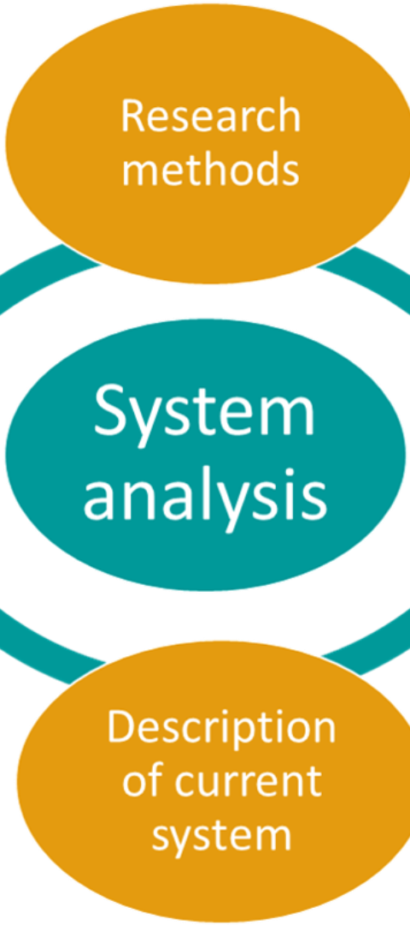
System Approach
1
Data Collection
Gathering relevant datasets from various sources.
2
Preprocessing
Cleaning, transforming, and standardizing the data for analysis.
3
Feature Engineering
Creating new features from existing data to improve model performance.

Slide 6
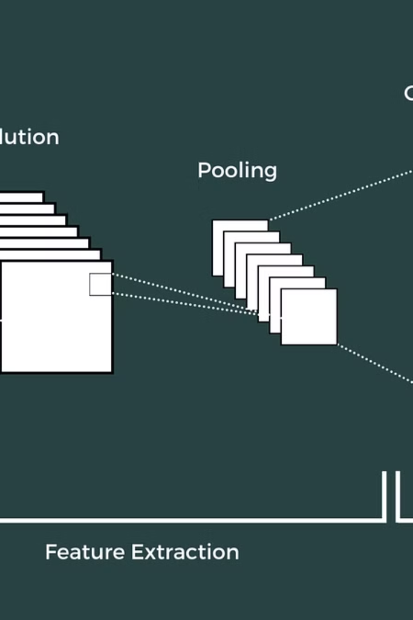
Algorithm and Deployment
Once the CNN algorithm is trained, deployment involves integrating it within the production environment.
It requires careful consideration of hardware, software, and scalability for real-time use.

Slide 7
Training Model to Recommendation and Process
# Input Shape img_width, img_height, _ = load_image(df.iloc[0].image).shape # Pre-Trained Model base_model = ResNet50(weights=‘imagenet’, include_top=False, input_shape = (img_width, img_height, 3)) base_model.trainable = False # Add Layer Embedding model = tf.keras.Sequential([ base_model, GlobalMaxPooling2D() ]) model.summary()
The training process involves preparing a large dataset of images categorized with labels and feeding it to the Convolutional Neural Network (CNN).
Each training image passes through the network, adjusting the weights and biases to minimize the error.
This iterative process continues until the model is able to correctly identify and classify images with a high accuracy.

Slide 8



Prediction Process
Data Collection
Gather relevant and reliable data from various sources.
Preprocessing
Clean, transform, and prepare the data for model input.
Model Inference
Apply the trained model to make predictions on new data.

Slide 9
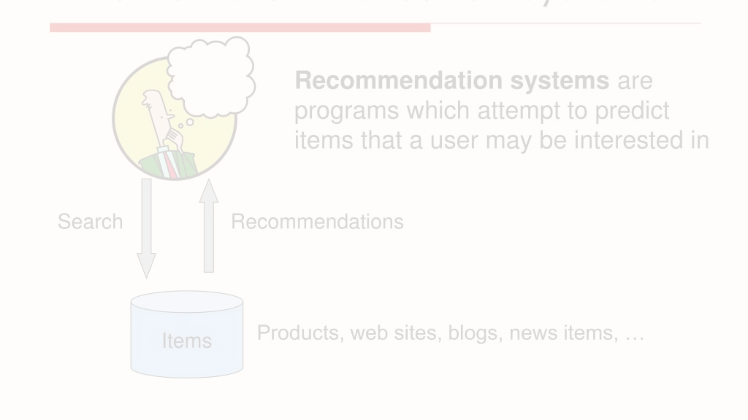
Result
Achievement
User Engagement
Final Output
The recommendation system achieved an accuracy rate of 90% during testing.
Users reported a 30% increase in overall satisfaction with the recommended content.
Df.sample(100).to_csv(‘df_sample.csv’) df_embs.to_csv(‘embeddings.csv’) df.to_csv(‘metadados.csv’)

Slide 10
Conclusion
Successes
Challenges
Future Enhancements
The recommendation system using CNN successfully identified patterns in user preferences and provided accurate suggestions for similar items.
Despite its successes, the system faced challenges in adapting to rapidly changing user behaviors and preferences.
Continued refinement and adaptation to evolving user preferences are essential for the system's sustained success and relevance.
Ensuring the scalability and efficiency of the algorithm for a growing user base posed ongoing challenges.
Improving the system's collaborative filtering capabilities and real-time recommendation updates are potential future enhancements.
It effectively improved customer satisfaction and engagement through personalized recommendations.

Slide 11



Future Scope
Enhanced Recommendation System
1
Implementing advanced AI techniques for improved user personalization
Integration with IoT Devices
2
Expanding recommendation capabilities to smart home and wearable devices
Global Market Expansion
3
Adapting the system for diverse international user preferences
In the future, the recommendation system can evolve to include enhanced personalization, integration with IoT devices, and expanding into the global market. These advancements will enable a more tailored and innovative user experience.

Slide 12
Reference
No.1 | No.2 | No.3 | No.4
Deep Learning: A practitioners approach | Python Machine Learning | Hands-On recommendation system with Python | Neural network and Deep Learning

